Slide 1
Understanding the modeling of Computer Network Delays using Neural Networks, ACM Big-DAMA 2018 workshop

Slide 2
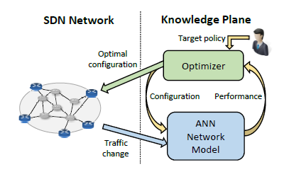
Complete system design
SDN network to provide centralized control
Optimizer to provide the optimal configuration to the SDN network
ANN to model the network and compute the performances
The optimizer uses the ANN to provide the best configuration eg: with a hill-climbing algorithm

Slide 3
Main contributions
Understand if Neural Networks can estimate the average delay of a network as a function of the traffic matrix
The analysis is based on other papers that suggest NN as modeling technique for computer networks
Other approaches: queuing (too simple), simulation (time expensive)
Among a class of network characteristics, which of them affect the accuracy of the NN
Determine a configuration (hyper-parameters) of the NN that best fit the delay estimation problem

Slide 4
Problem statement
The function that they want to model is D = f(T).
D and T are NxN matrices.
D: the average delay between the i (row) node and the j (column) node.
T : the amount of traffic between i and j in an N nodes network.
The delay from i to j is determined by the quantity of traffic sent between these nodes and the quantity of traffic sent between other nodes that share part of the path.

Slide 5
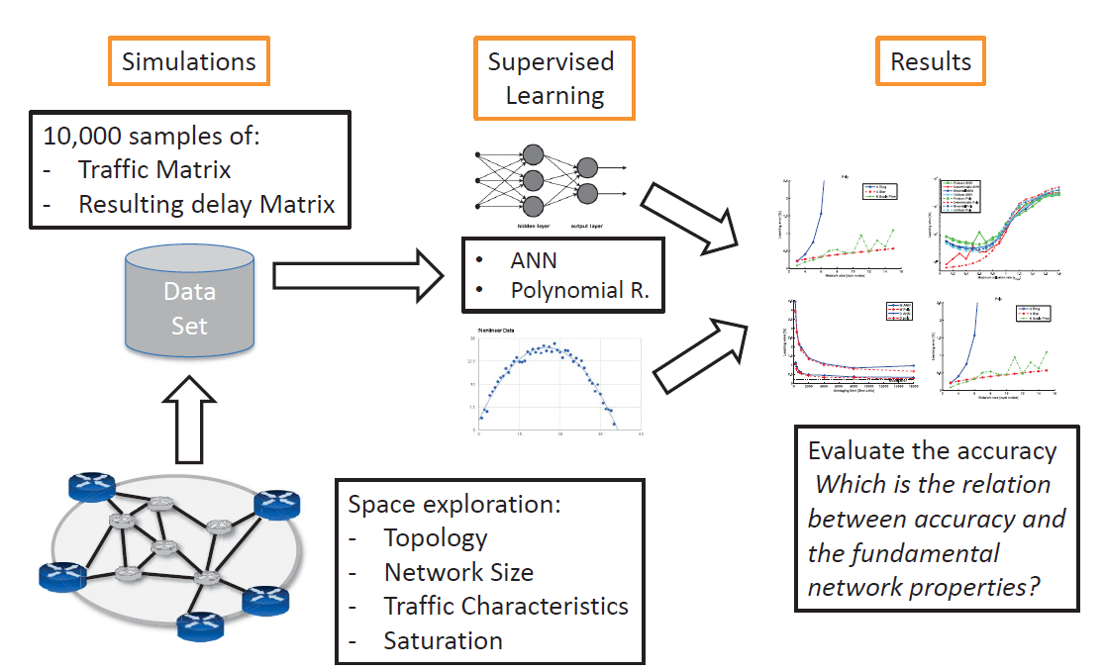
Scheme of the methodology followed in this work

Slide 6
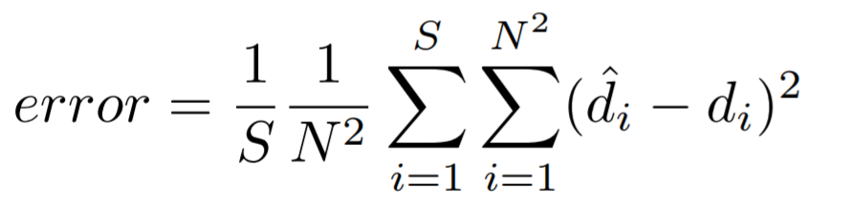
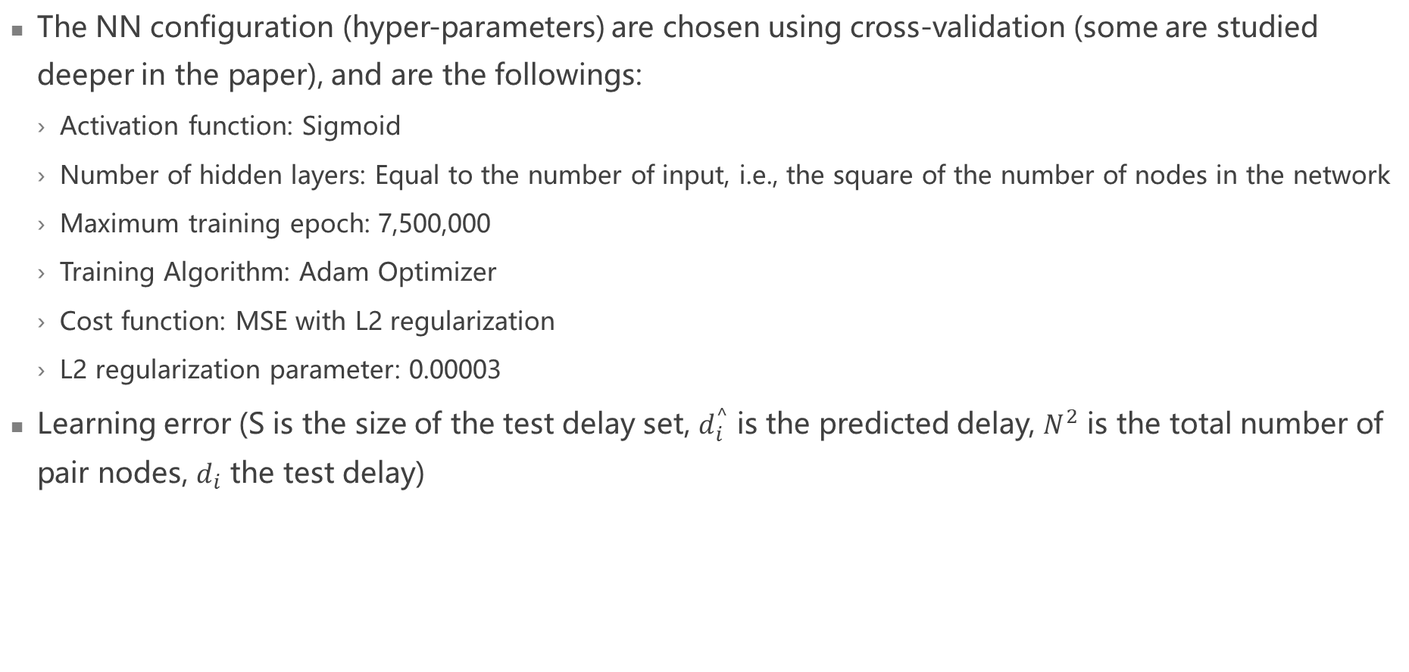
Advanced description of the work
The NN configuration (hyper-parameters) are chosen using cross-validation (some are studied deeper in the paper), and are the followings:
Activation function: Sigmoid
Number of hidden layers: Equal to the number of input, i.e., the square of the number of nodes in the network
Maximum training epoch: 7,500,000
Training Algorithm: Adam Optimizer
Cost function: MSE with L2 regularization
L2 regularization parameter: 0.00003
Learning error (S is the size of the test delay set, $d_{i}^{^}$ is the predicted delay, $N^{2}$ is the total number of pair nodes, $d_{i}$ the test delay)

Slide 7
Simulations (1/2)
To generate the dataset, in this work, they use the Omnet++ simulator (version 4.6)
In each simulation, they measure the average end-to-end delay during 16k units of time for all pairs of nodes.
Topology: unidirectional ring, star, and scale-free networks
Size: 3 to 15 nodes (all nodes are active transmitters and receivers)
Packet length distributions: deterministic (constant), uniform, binomial and Poisson using a fixed average packet length. In all cases, the inter-arrival time is exponential.
Traffic intensity: Different levels of saturation in the network (by varying the traffic intensity) ➔ Transmit, among all pairs of nodes, a random value of traffic with a maximum value (ro_max). From very low (ro_max=0.1) up to highly saturated networks (ro_max > 1)
Routing: Three different routing configurations: SP (Shortest Path), MAN (more load balancing), POOR (few links are intentionally saturated)

Slide 8
Simulations (2/2)
They generate more than 400 different datasets with different configurations ( https://github.com/knowledgedefinednetworking ) .
Each dataset consists of 10,000 different simulations (samples)
Each sample contains the random traffic matrix, which is used as the input features in the ML model, and the delay matrix, which is used as the output features.
Each dataset is divided into three sets to train, validate and test each model.

Slide 9
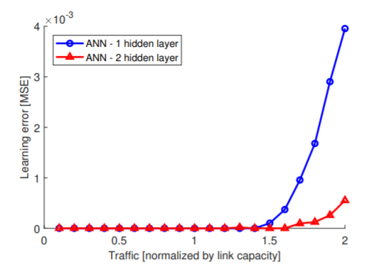
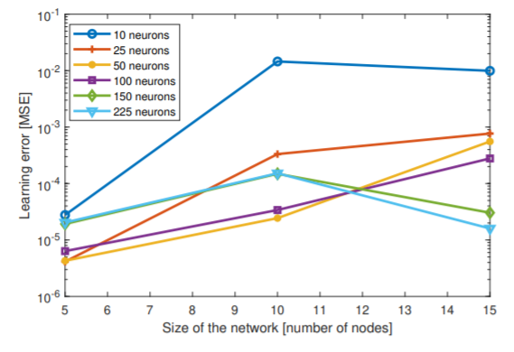
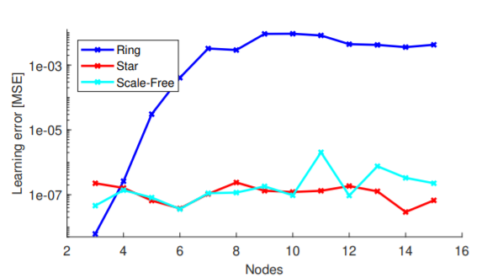
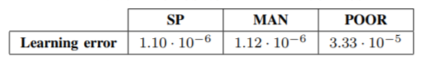
Results
Traffic characteristic and intensity
Topologies and network size
Routing policy
Number of neurons per hidden layer
Activation function: sigmoid wins in high loads situation against tanh and ReLU, that work vell only with low loads
In realistic environment, learning error is lower than 1% even with high loads

Slide 10
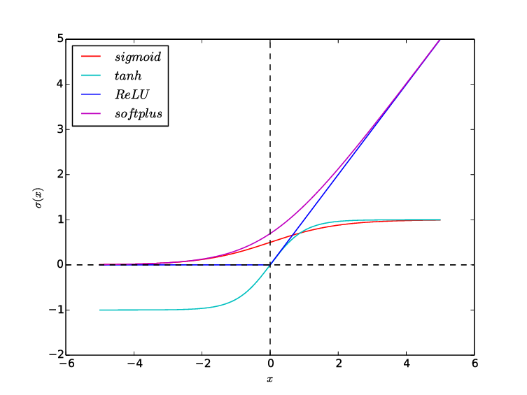
Conclusions
Simple NNs do not perform well suggests that the delay function is complex and multi-dimensional, requiring sophisticated regression techniques such as deep NNs.
Deeper networks (Deep Neural Networks, DNNs) are required for saturated networks. This is because saturated networks result in more complex functions that require additional layers.
NN must be considered as a relevant tool for estimating average delay
For the considered scenarios, the topology or the size has no impact on the accuracy of the NN estimates.
But they do reach saturation in a different way
In this set of experiments we have not seen any impact of the routing policy on the accuracy of the NN. The only impact is again related to the queuing, if the routing policy produces saturation
So, saturation (as traffic intensity) is the only parameter that increases the complexity of the model
Activation function: sigmoid, hyperbolic tangent, rectifier with the same set of
hyper-parameters ➔ better results with the sigmoid activation fct.

Slide 11
Strengths and falls
Strenghts
Falls
Model is built only considering the traffic matrix. No learning based on the configuration
Accurate in complex scenarios
Big advantage wrt queuing theory
Fast and light-weight
Big advantage wrt simulations
If combined to SDN and NA to form a KDN, can be used for control and online learning
Different results depending on the topology and the routing protocol, even though they are due to reached saturation
Data-driven approach: high dependence on data (as a ML technique) that implies that data must be reliable. Not true in networking field, as they are simulated
The results has been reported after the unavoidable variance has been subtracted
No online learning (no adaptability during time)
Give great information on how far could NN give to estimating QoS

Slide 12
Improvements
Improve the dataset quality by using data extrapolated from real measurements, not simulated
This data could also be used to estimate the error obtained during the simulations
Perform online learning using the data extrapolated from the SDN
Extend the approach to understand the behavior of the network on different network configurations
Generative approach. Output as a distribution, not an average (compare with the other paper)
Being the delay a random variable, a generative approach could better suit the problem, if the data are sampled from the generative model

